Slide 1


Hoang Duc Mai
Sep 20th, 2024

Slide 2

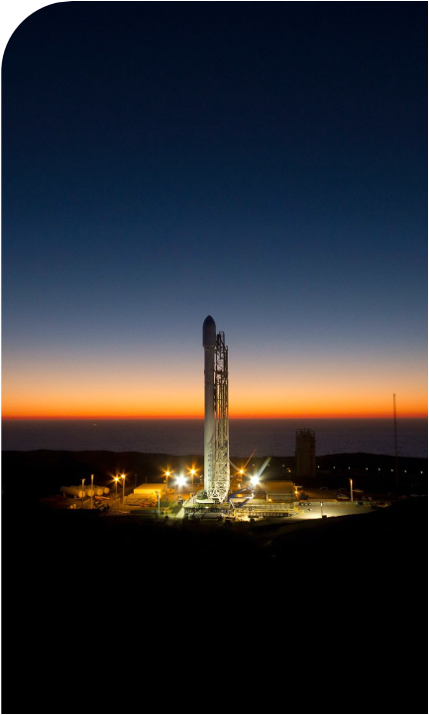
Outline
Executive Summary
Introduction
Methodology
Results
Conclusion
Appendix

Slide 3
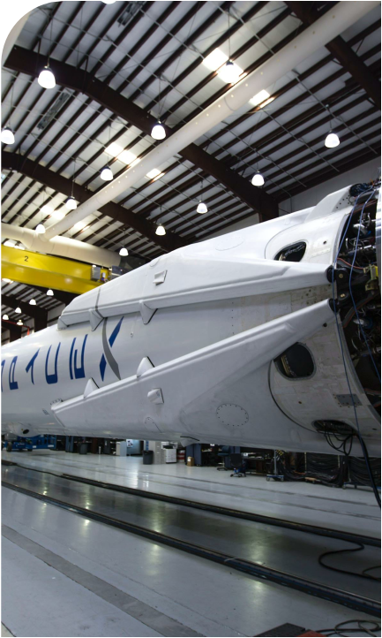
Executive Summary
Summary of methodologies
The research attempts to identify the factors for a successful SPACEX rocket landing
Data collection from SpaceX REST API and relevant Wikipedia page
Data wrangling => Exploratory Data Analysis and determine Training Labels
Data exploration and analysis => factors impact mission outcomes
Visualisation of launch sites with the most success rates and payload range
Machine learning techniques to predict landing outcomes
Summary of all results
Launch success rate over time
Site and orbit with highest successful rate
Features of launch site
Performance of prediction models

Slide 4

Introduction
BACKGROUND AND CONTEXT
SpaceX's reusable first stage rocket
Significantly reduction of cost of space launch
Space exploration more accessible.
PROBLEMS
Which factors influence the Reusability of SpaceX’s first stage rocket?

Slide 5

Section 1

Slide 6
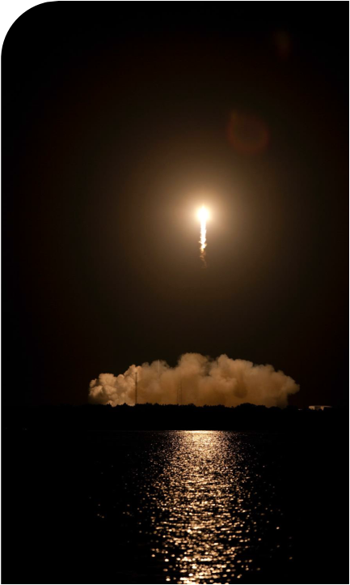
Methodology
Executive Summary
Data collection methodology:
REST API
Web scraping (from Wikipedia)
Perform data wrangling
Filter data to keep the Falcon 9 launches
Remove missing values
Determine Training Label

Slide 7
Methodology (cont.)
Perform exploratory data analysis (EDA) using visualization and SQL
Factors influence to landing outcomes (site, booster type, orbits, payload mass)
Perform interactive visual analytics using Folium and Plotly Dash
Successful rate for each factors (launch site, payload)
Map of site locations and their success/failed launches
Perform predictive analysis using classification model
Support Vector Machine, Logistic Regression, KNN, Decision Tree

Slide 8
Data Collection – Using SpaceX’s REST API
Request and parse the SpaceX launch data using the GET request
Decode and turn the response content to Pandas Dataframe using JSON method
Call flight information using APIs obtained from column data
Append data to the lists
Combine lists of data and convert to Pandas Dataframe
Send GET requests
Decode and convert JSON data to Dataframe
Use columns data to call the APIs for flights info
Combine and convert data to Pandas Dataframe
Parse JSON response
https://github.com/HoangDucMai/IBM-Data-Science---Capstone-project/blob/main/jupyter_labs_spacex_data_collection_api%20-%20DMA.ipynb

Slide 9
Data Collection – Scraping from Wikipedia
Send GET request
Extract table and columns name using BeautifulSoup
Parse HTML table for launch record
Convert data to Pandas Dataframe
Create BeautifulSoup object from HTML response
HTTP GET method to request the Falcon9 Launch HTML Wikipedia page
Use find_all method of BeautifulSoup to parse table and columns
Extract data from HTML tables to fill in the dictionary
Covert dictionary to Pandas dataframe using pd.Dataframe method()
https://github.com/HoangDucMai/IBM-Data-Science---Capstone-project/blob/main/jupyter_labs_webscraping%20-%20DMA.ipynb

Slide 10
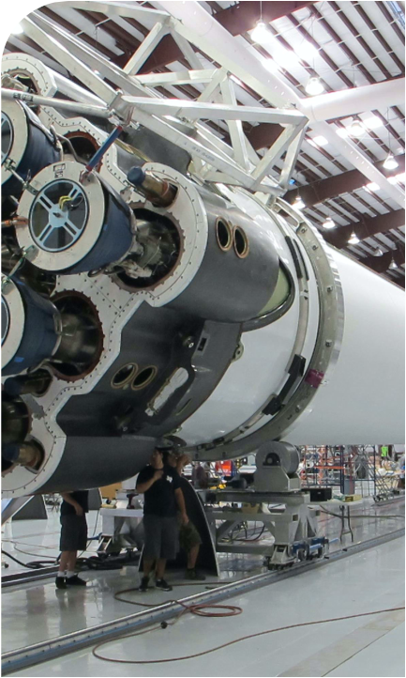
Data Wrangling
Understand Dataset
(column type, missing values)
Replace missing values
(Landing Pad)
Explore independent variables
(launch sites, orbits, occurrence of mission)
Filter Dataset to only include data of interest
(Falcon 9 launches)
Create dummy variables to categorical columns
(Orbits, Launch site, Landing pad, Serial)
Cast all numeric columns to Float 64
Create categorical dependent variable
(Landing class)
Explore and prepare dependent variable
(Landing Outcome)
Export Data to CSV file for further exploratory tasks
https://github.com/HoangDucMai/IBM-Data-Science---Capstone-project/blob/main/labs_jupyter_spacex_Data_wrangling%20-%20DMA.ipynb

Slide 11
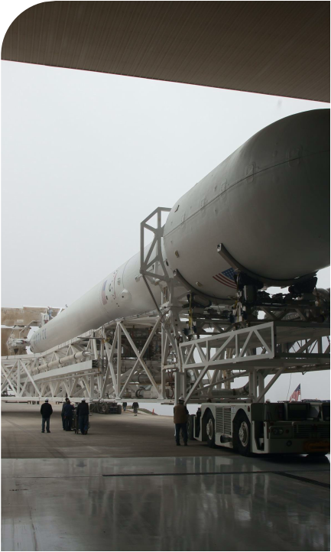
EDA with Data Visualization
Identify trends or patterns between launch features
Flight Number vs Payload Mass
Flight Number vs. Launch Site
Payload Mass (kg) vs. Launch Site
Success rate of each orbit type
Flight number vs Orbit type
Payload Mass vs Orbit type
Launch Success trend
Identify factors influence dependent variable
https://github.com/HoangDucMai/IBM-Data-Science---Capstone-project/blob/main/edadataviz%20-%20DMA.ipynb

Slide 12
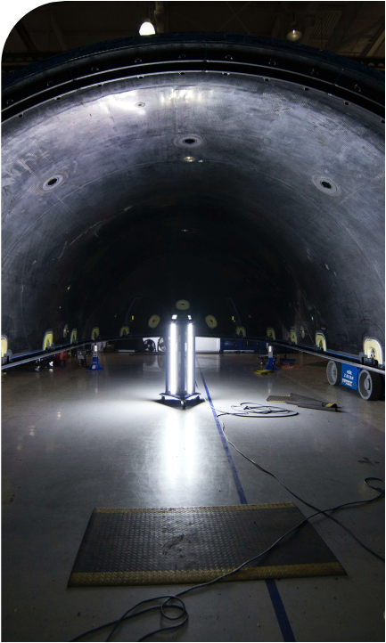
EDA with SQL
Name of unique launch sites
Payload Mass by booster type
Booster launch by NASA (CRS)
Booster version F9 v1.1
Date of first successful landing
Booster which have success in drone ship and have payload mass in range of 4000 – 6000kg
Total number of successful and failure outcomes
Booster carried the maximum payload mass
Count of landing outcomes for a certain period
https://github.com/HoangDucMai/IBM-Data-Science---Capstone-project/blob/main/jupyter_labs_eda_sql_coursera_sqllite%20-%20DMA.ipynb

Slide 13
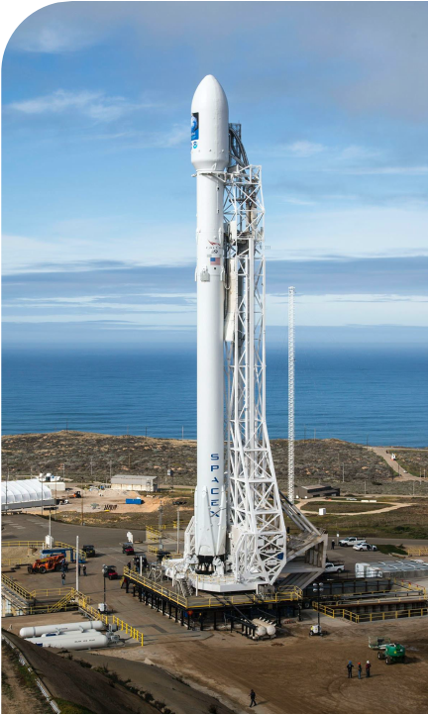
Build Interactive Map with Folium
A map was prepared to provide information on:
Location of NASA – blue circle with marker
Launch sites – orange circles with markers
Launch record with color-labeled marker for success / failure
Distance from a launch site (CCAFS SLC-40) to the nearest populated area/highway/railway or coastline
https://github.com/HoangDucMai/IBM-Data-Science---Capstone-project/blob/main/lab_jupyter_launch_site_location%20-%20DMA.ipynb

Slide 14
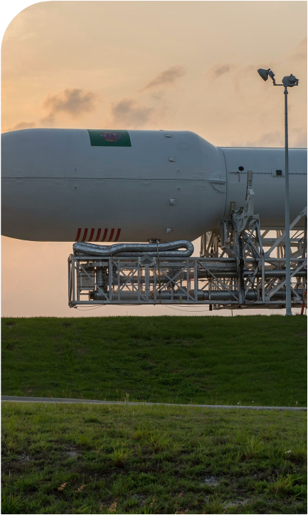
Build Dashboard with Plotly Dash
The dashboard providing overview on success rate for payload and launch site was developed with the following items:
A drop-down menu for selection of a specific launch site or all sites
A pie chart visualizing launch success rate for the selected launch site option
A range slider to select payload up to 10,000 kg
A scatter plot visualising selected payload range for the nominated launch site option
https://github.com/HoangDucMai/IBM-Data-Science---Capstone-project/blob/main/spacex_dash_app%20-%20DMA.py

Slide 15
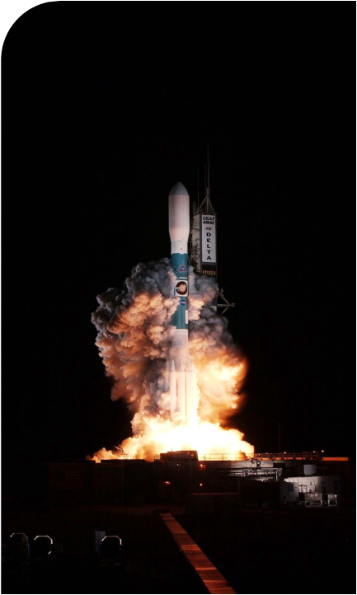
Predictive Analysis (Classification)
Dependent variable: (Outcome class)
Independent variables: Flight Number, Payload Mass, Orbit, Launch site, flights, Reused, etc. are converted from categorical data into numerical data by creating binary columns for each unique category.
Independent variables are standardized to improve the performance of machine learning algorithms
Dataset is split to 2 subsets: train (80%) and test (20%)
Machine learning algorithms applied: Logistic regression, Support vector machine, Decision tree, K Nearest Neighbour
Compare accuracy using method score to select the best algorithms
https://github.com/HoangDucMai/IBM-Data-Science---Capstone-project/blob/main/SpaceX_Machine_Learning_Prediction_Part_5%20-%20DMA.ipynb

Slide 16
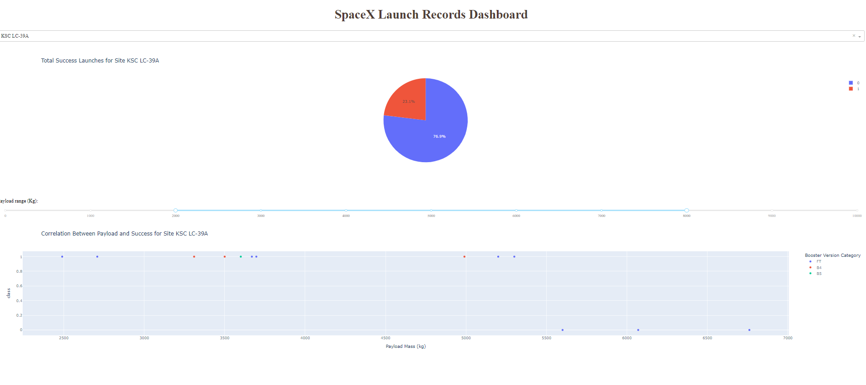
Results
Exploratory data analysis results
Launch success improved over time
KSC LC-39A has the highest success rate among landing sites (76.9%)
Orbits ES-L1, GEO, HEO and SSO have a 100% success rate
Predictive analysis results
All models have same accuracy score (83.33%)
Decision tree has the highest accuracy (87.5%)
Interactive analytics demo

Slide 17

Section 2

Slide 18
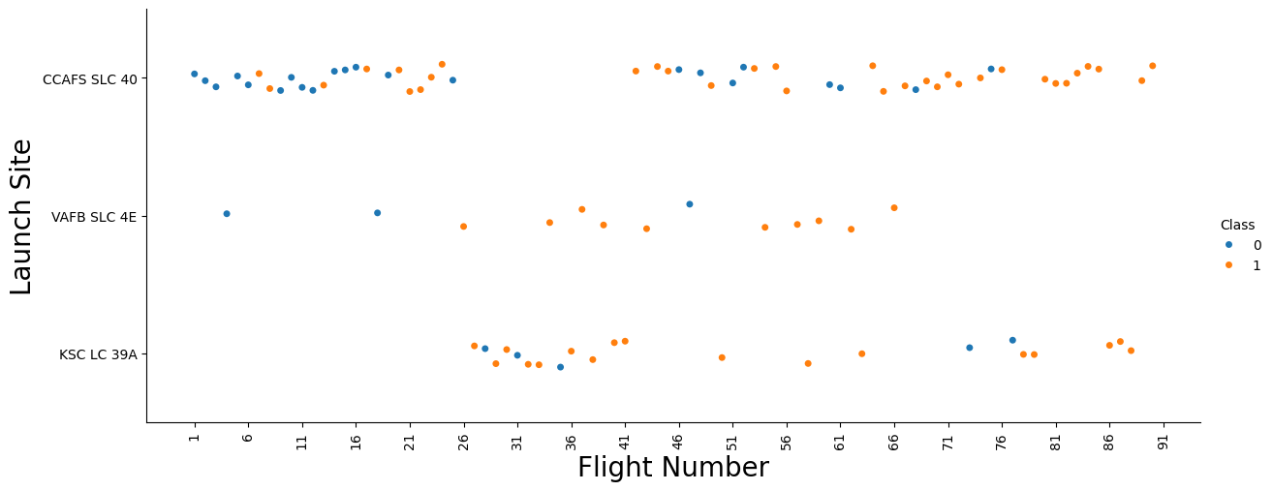
Flight Number vs. Launch Site
Success rate for each site improves over time
CCAFS SLC 40 has the most launch

Slide 19
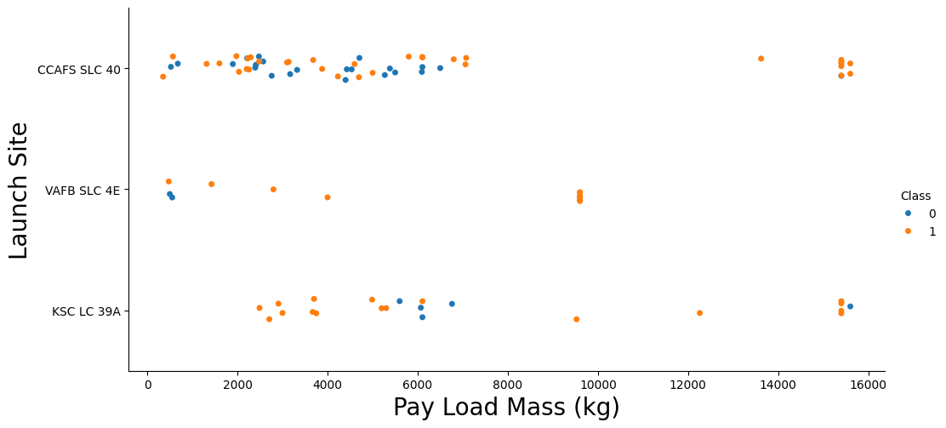
Payload vs. Launch Site
CCAFS SLC 40 has higher success rate for heavier payload mass
KSC LC 39A has 100% success rate for launches less than 5,500kg
Most launches with a payload greater than 7,000 kg were successful

Slide 20
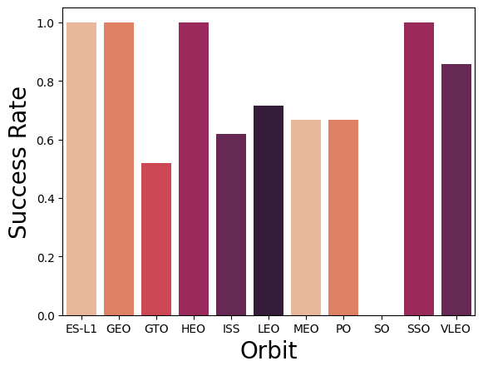
Success Rate vs. Orbit Type
Mission(s) to SO was not successful
Except mission to SO, other orbit has at least 50% successful rate
Most successful orbits: SSO, GEO, HEO and ES-L1

Slide 21
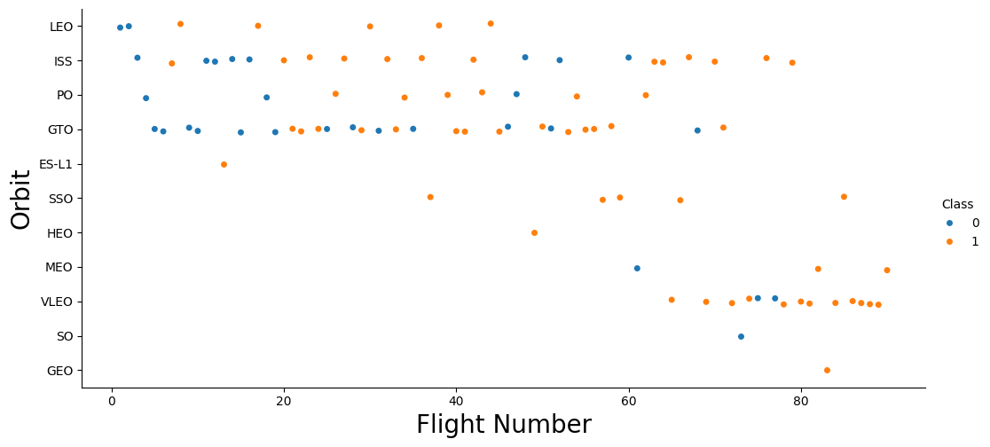
Flight Number vs. Orbit Type
Most common orbits are ISS and GTO
SSO, ES-L1, HEO and GEO have high successful rate but low number of flight
Success rate typically increases with the number of flight for each orbit except GTO

Slide 22
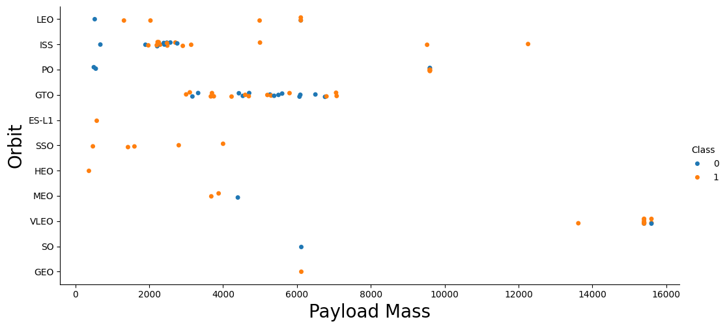
Payload vs. Orbit Type
Correlation between orbit type and payload mass
Wider range of payload mass to ISS
VLEO has highest payload mass flights

Slide 23
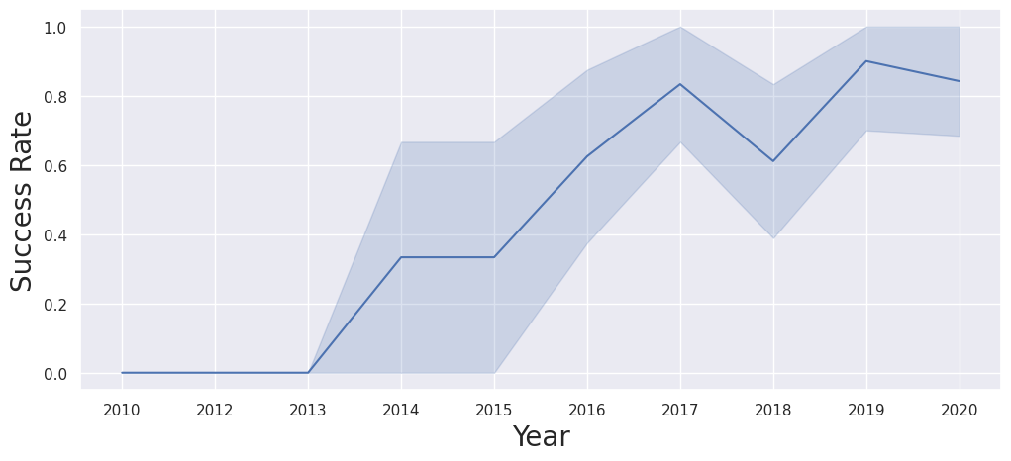
Launch Success Yearly Trend
Success rate of Falcon 9 booster typically improves over time
5 failures in 2018 dipped the success rate for that year

Slide 24
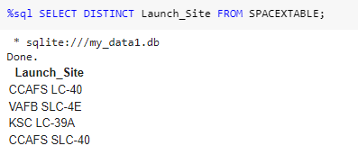
All Launch Site Names
Use SQL to query launch site from the table
%sql: magic command in Jupyter Notebook to indicate the code is an SQL query
SELECT DISTINCT: select unique values from the table
FROM: nominate source of query

Slide 25
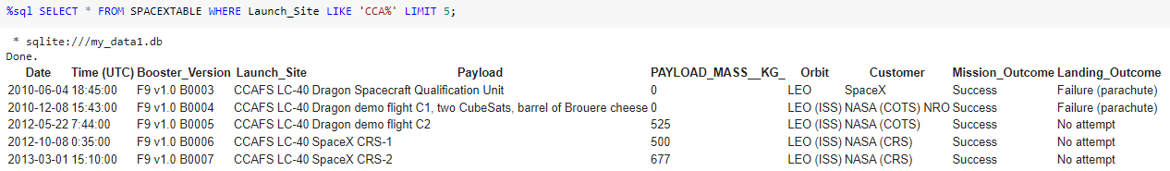
Launch Site Names Begin with 'CCA'
Use SQL to query launch site from the table
%sql: magic command in Jupyter Notebook to indicate the code is an SQL query
SELECT *: selects all columns from the table
FROM: specifies the table from which to retrieve data
WHERE column_name: filters the results to only include rows where the nominated column satisfy condition
LIKE ‘string’: operator allows for ‘string’ matching
LIMIT number: limits the number of rows return to the first nominated number

Slide 26
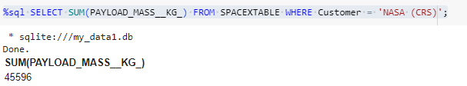
Total Payload Mass
Use SQL to query launch site from the table
%sql: magic command in Jupyter Notebook to indicate the code is an SQL query
SELECT function(‘column_name’): selects only calculated value from the ‘column_name’. The value will be calculated by math function
FROM: specifies the table from which to retrieve data
WHERE column_name: filters the results to only include rows where the nominated column satisfy condition
= ‘string’: operator to match ‘string’

Slide 27
Average Payload Mass by F9 v1.1
Calculate the average payload mass carried by booster version F9 v1.1
Present your query result with a short explanation here

Slide 28
First Successful Ground Landing Date
Find the dates of the first successful landing outcome on ground pad
Present your query result with a short explanation here

Slide 29
Successful Drone Ship Landing with Payload between 4000 and 6000
List the names of boosters which have successfully landed on drone ship and had payload mass greater than 4000 but less than 6000
Present your query result with a short explanation here

Slide 30
Total Number of Successful and Failure Mission Outcomes
Calculate the total number of successful and failure mission outcomes
Present your query result with a short explanation here

Slide 31
Boosters Carried Maximum Payload
List the names of the booster which have carried the maximum payload mass
Present your query result with a short explanation here

Slide 32
2015 Launch Records
List the failed landing_outcomes in drone ship, their booster versions, and launch site names for in year 2015
Present your query result with a short explanation here

Slide 33
Rank Landing Outcomes Between 2010-06-04 and 2017-03-20
Rank the count of landing outcomes (such as Failure (drone ship) or Success (ground pad)) between the date 2010-06-04 and 2017-03-20, in descending order
Present your query result with a short explanation here

Slide 34

Section 3

Slide 35
<Folium Map Screenshot 1>
Replace <Folium map screenshot 1> title with an appropriate title
Explore the generated folium map and make a proper screenshot to include all launch sites’ location markers on a global map
Explain the important elements and findings on the screenshot

Slide 36
<Folium Map Screenshot 2>
Replace <Folium map screenshot 2> title with an appropriate title
Explore the folium map and make a proper screenshot to show the color-labeled launch outcomes on the map
Explain the important elements and findings on the screenshot

Slide 37
<Folium Map Screenshot 3>
Replace <Folium map screenshot 3> title with an appropriate title
Explore the generated folium map and show the screenshot of a selected launch site to its proximities such as railway, highway, coastline, with distance calculated and displayed
Explain the important elements and findings on the screenshot

Slide 38

Section 4

Slide 39
<Dashboard Screenshot 1>
Replace <Dashboard screenshot 1> title with an appropriate title
Show the screenshot of launch success count for all sites, in a piechart
Explain the important elements and findings on the screenshot

Slide 40
<Dashboard Screenshot 2>
Replace <Dashboard screenshot 2> title with an appropriate title
Show the screenshot of the piechart for the launch site with highest launch success ratio
Explain the important elements and findings on the screenshot

Slide 41
<Dashboard Screenshot 3>
Replace <Dashboard screenshot 3> title with an appropriate title
Show screenshots of Payload vs. Launch Outcome scatter plot for all sites, with different payload selected in the range slider
Explain the important elements and findings on the screenshot, such as which payload range or booster version have the largest success rate, etc.

Slide 42

Section 5

Slide 43
Classification Accuracy
Visualize the built model accuracy for all built classification models, in a bar chart
Find which model has the highest classification accuracy

Slide 44
Confusion Matrix
Show the confusion matrix of the best performing model with an explanation

Slide 45
Conclusions
Point 1
Point 2
Point 3
Point 4
…

Slide 46
Appendix
Include any relevant assets like Python code snippets, SQL queries, charts, Notebook outputs, or data sets that you may have created during this project

Slide 47


